Slide 1
MySQL
Avancerede teknikker

Slide 2
AGENDA
Formålet er at give en dybere forståelse af, hvordan man arbejdereffektivt med MySQL i komplekse scenarier.
CRUD-operationer ( Read, Update, Delete) og deres syntaks.
Brug af SELECT, herunder WHERE, aliaser og sortering
UPDATE og DELETE kommandoer til ændring og fjernelse af data.
ALTER og DROP til ændring af tabelstruktur og sletning af tabeller.
SQL Views til rapportering og genbrug af forespørgsler.
INNER JOIN til at kombinere data fra flere tabeller.

Slide 3
CRUD
Create
Read
Update
Delete

Slide 4
READ
Syntax:
Here is generic SQL syntax of SELECT command to fetch data from MySQL table:
SELECT field1, field2,...fieldN FROM table_name1, table_name2... [WHERE Clause]
Notes:
The SQL SELECT command is used to fetch data from MySQL database. You can use this command at mysql> prompt as well as in any script like PHP.

Slide 5
SELECT * FROM album;

Slide 6
SELECT artist,label from album where label= 'Columbia';
Notes:
Note use ‘ ‘ when varchar, not use ‘’ when int
select artist,label from album where label='Columbia’;
Notice sql is not case sensitive ( email address)

Slide 7
SELECT label, artist from album order by artist DESC;
Notes:
https://www.w3schools.com/mysql/mysql_orderby.asp

Slide 8
UPDATE
Syntax:
UPDATE table_name SET
column_name1 = expr1, column_name2 = expr2,
...
WHERE
condition;
Notes:
We use the UPDATE statement to update existing data in a table.
We can use the UPDATE statement to change column values of a single row, a group of rows, or all rows in a table.

Slide 9
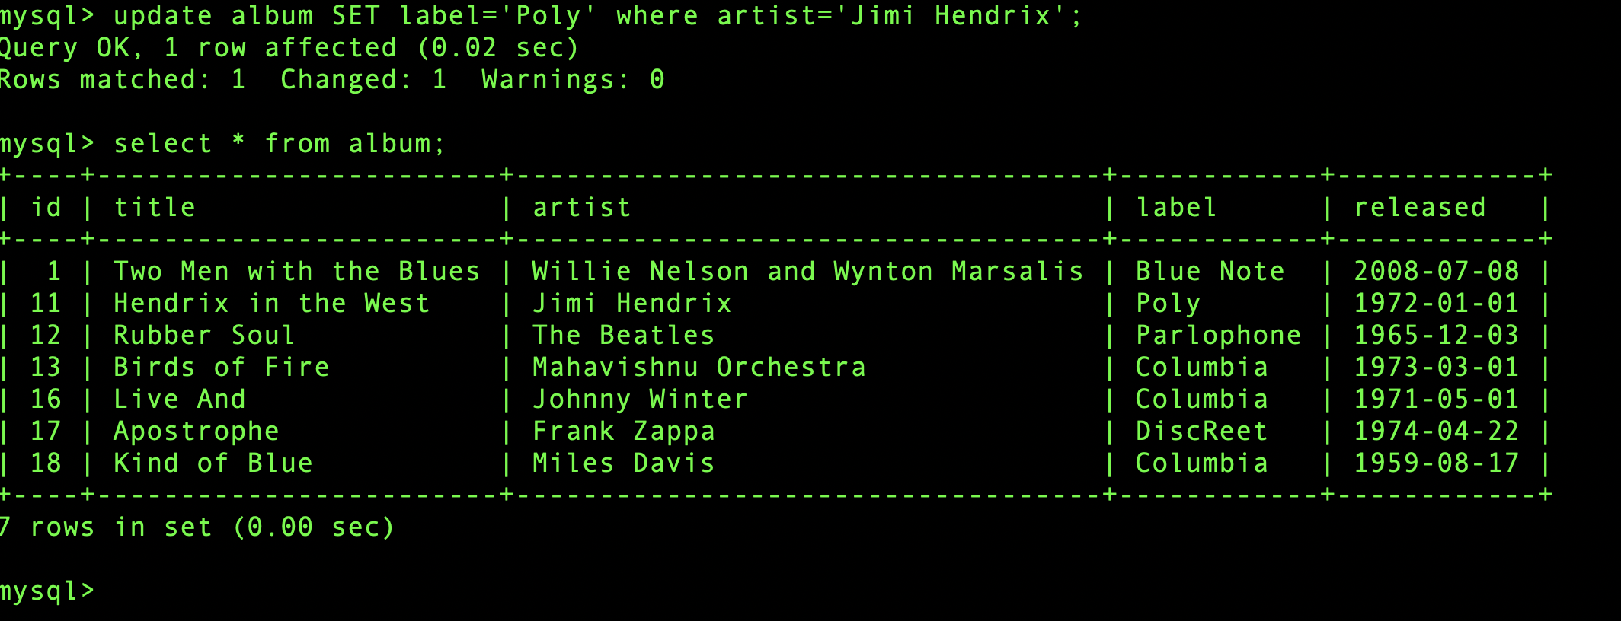
UPDATE

Slide 10
DELETE
Syntax:
DELETE FROM table
[WHERE conditions]
DELETE FROM album WHERE id=18;
Notes:
MySQL DELETE statement allows you to remove records from not only one table but also multiple tables using a single DELETE statement.

Slide 11
ALTER
Syntax:
ALTER TABLE table_name action1[,action2,…]
Notes:
Alter tables:
The ALTER TABLE statement allows you to add a column, drop a column, change the data type of column, add primary key, rename table, and many more.

Slide 12
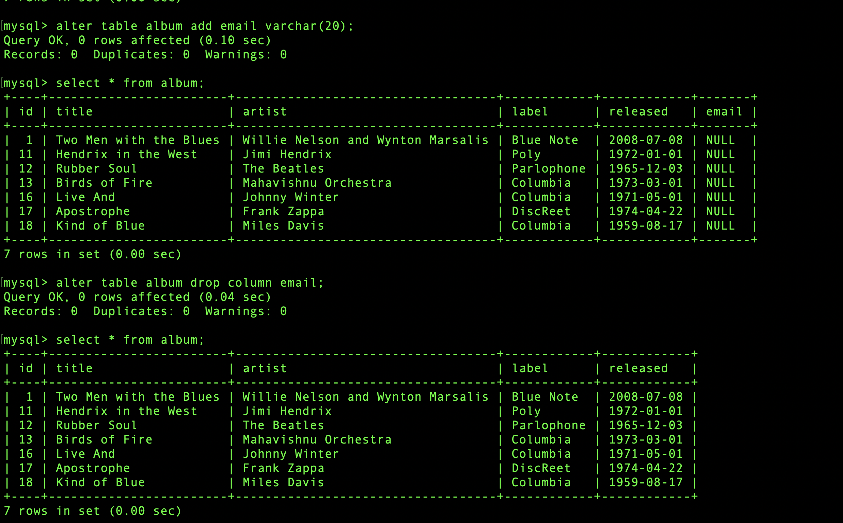

Slide 13
DROP
Syntax:
DROP TABLE table_name;
Notes:
It is very easy to drop an existing MySQL table, but you need to be very careful while deleting any existing table because data lost will not be recovered after deleting a table.
Drop database
https://www.w3schools.com/mysql/mysql_drop_db.asp

Slide 14
SQL VIEW –- til Rapportering og Analyse
Foruddefinerede beregninger (fx salgstotaler, månedlig omsætning)
Eksempel: monthly_sales_view

Slide 15
SQL VIEW Genbrug af Query-logik
Genbrug af Query-logik
Skriv en forespørgsel én gang og genbrug den i flere rapporter eller procedurer

Slide 16
SQL - CREATE VIEW demo
CREATE VIEW album_release_info AS
SELECT
id,
title,
artist,
YEAR(released) AS release_year,
MONTH(released) AS release_month
FROM album;
35

Slide 17
View→ Genbrug af Query
SELECT *
FROM album_release_info
WHERE release_month IN (1, 2, 3);

Slide 18
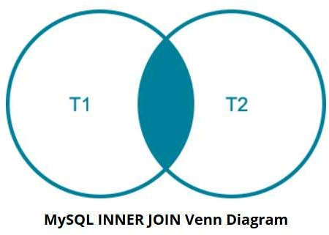
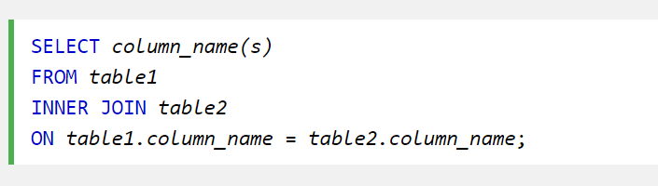
INNER JOIN
The following Venn diagram illustrates how the MySQL INNER JOIN clause
works. The rows in the result set must appear in both tables: T1 and T2.

Slide 19
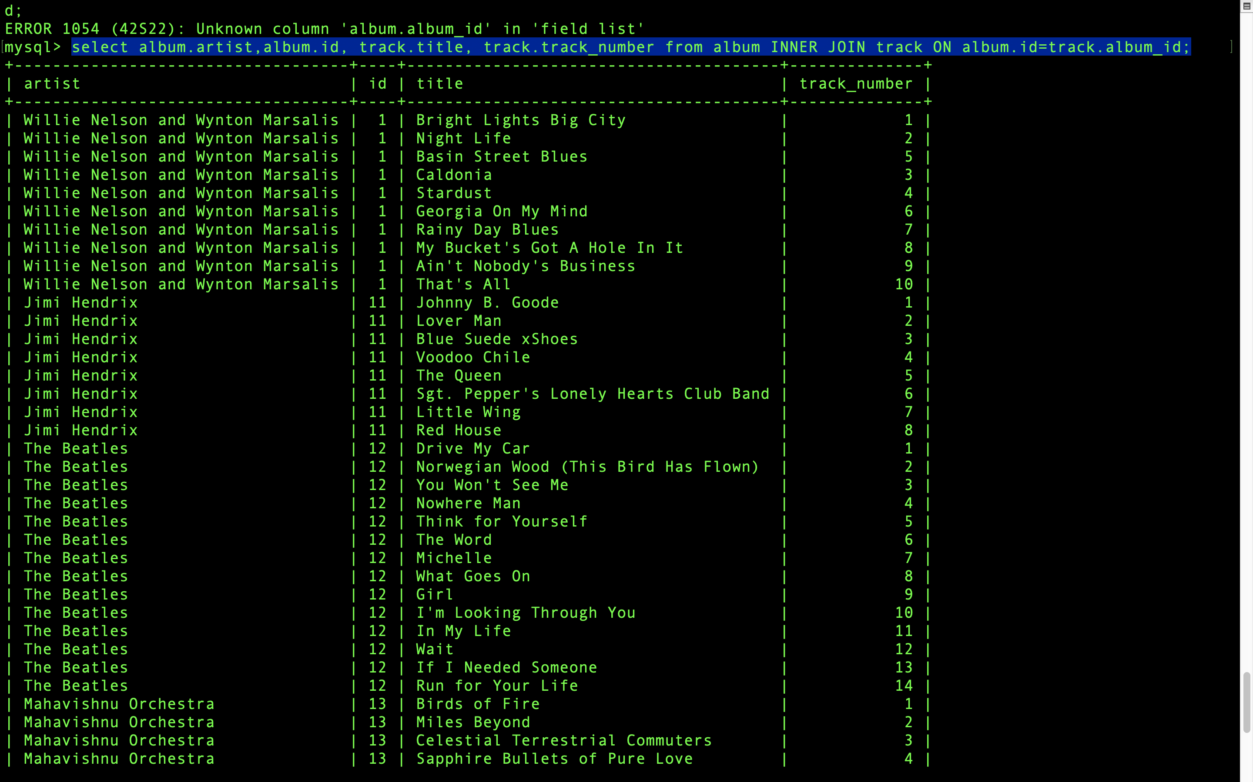
Notes:
select album.artist,album.id, track.title, track.track_number from album INNER JOIN track ON album.id=track.album_id;

Slide 20
Mini Quiz
Hvad står CRUD for i databaser?
Hvilken SQL-kommando bruges til at hente data fra en tabel?
Hvad gør ORDER BY i en SELECT-forespørgsel?
Nævn én fordel ved at bruge Views.
Hvad returnerer en INNER JOIN?

Slide 21
Præsentation I gruppen

